Slide 1
12460 - Little Brick's Choice

Slide 2
Input
Input contains only 1 line, representing the list of some characters that can be used in the password.
It is guaranteed that the characters will not be duplicated,
and 4 <= length of the given list <= 16, and the characters will only be lowercase or uppercase alphabet.

Slide 3
Output
Output contains only one line.
List all possible passwords in lexicographical order, separated by ", " (without quotes)
Remember to add a newline character after your output.

Slide 4
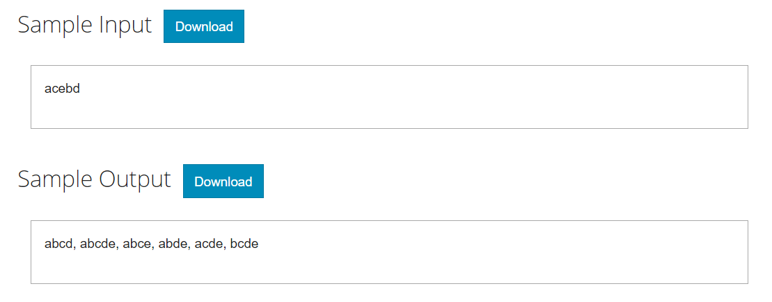
Sample Input/Output

Slide 5
char in[16+1]={'\0'};
char _in[16+1]={'\0'}; //sorted
int inLen;
int npasswd;
char passwd[16+1];
void perm(int pos, int start, int end);
int main(void)
{
…
scanf("%s",in);
//Sort the input array in[] and get the sorted version _in[]
perm(0,0,inLen-1);
…
return 0;
}

Slide 6
void perm(int pos, int start, int end)
{
int i;
//basis step
if(???)
{
npasswd++;
passwd[pos]='\0';
if(npasswd==1) printf("%s",passwd);
else printf(", %s",passwd);
}
//recursive step
for(i=???;i<=???;i++)
{
passwd[???]=_in[i];
perm(???,???,???);
}
}

Slide 7
void perm(int pos, int start, int end)
{
int i;
//basis step
if(pos>=4)
{
npasswd++;
passwd[pos]='\0';
if(npasswd==1) printf("%s",passwd);
else printf(", %s",passwd);
}
//recursive step
for(i=start;i<=end;i++)
{
passwd[pos]=_in[i];
perm(pos+1,i+1,end);
}
}

